Slide 1
Lead Score Case Study
By
ANJALI MISHRA
B.BHARATH REDDY

Slide 2
Problem Statement :
X Education sells online courses to industry professionals. The company markets its courses on several websites and search engines like Google. Once these people land on the website, they might browse the courses or fill up a form for the course or watch some videos. When these people fill up a form providing their email address or phone number, they are classified to be a lead. Moreover, the company also gets leads through past referrals. Once these leads are acquired, employees from the sales team start making calls, writing emails, etc. Through this process, some of the leads get converted while most do not. The typical lead conversion rate at X education is around 30%.
Business Goal:
X Education needs help in selecting the most promising leads, i.e. the leads that are most likely to convert into paying customers. The company needs a model wherein you a lead score is assigned to each of the leads such that the customers with higher lead score have a higher conversion chance and the customers with lower lead score have a lower conversion chance. The CEO, in particular, has given a ballpark of the target lead conversion rate to be around 80%.

Slide 3
Approach to be followed for the Model Building
Read and understand historical lead data
Clean the data
Prepare data
Spilt Train & Test data
Feature Scaling
Check for correlations between variables
Build the model
Feature Selection using RFE
Assessing the Model with Statsmodel
Verify model against metrics
Plot ROC Curve
Identify optimal cut-off points
Make predictions on the Test set
Assign Lead Scores
Conclude the analysis

Slide 4
Initial observations from Data
The Leads data provided by Education company has 9240 rows and 37 columns
There are a few rows with missing values, that needs attention. Such as
Lead Source
Total Visits
Page Views Per Visit
Country
Last Activity
What is your current occupation
What matters most to you in choosing a course
There are certain columns that have ‘Select’ as label possibly because these are dropdown.
It looks like there are outliers present in 'Total Time Spent on Website', 'TotalVisits', 'Page Views Per Visit', since the mean is almost twice or more than 50th percentile

Slide 5
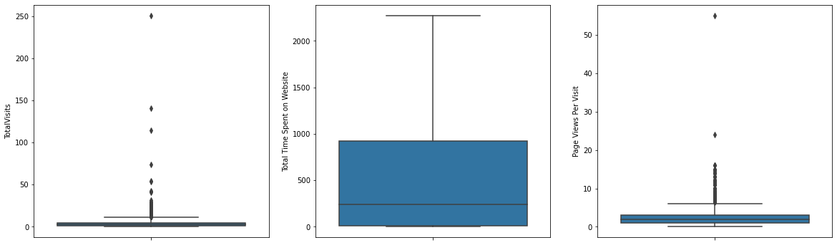
Outlier Treatment
Outliers present in 'Total Time Spent on Website', 'TotalVisits', 'Page Views Per Visit’ so any data above ’99th percentile’ was omitted to limit data from skewing.

Slide 6
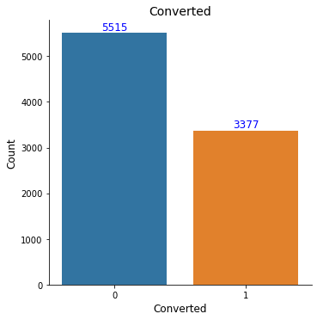
Data Analysis
We have 38% conversion rate so there is no class imbalance.

Slide 7
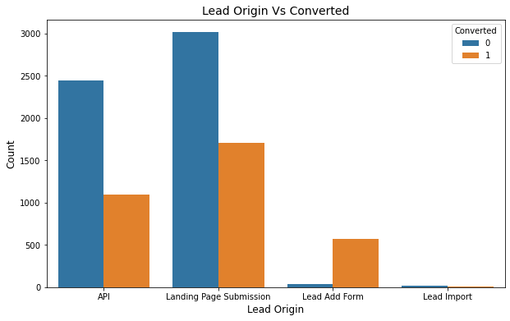
Data Analysis
From the above graph, maximum conversion happened from 'Landing Page Submission' but 'API' has better covertion rate

Slide 8
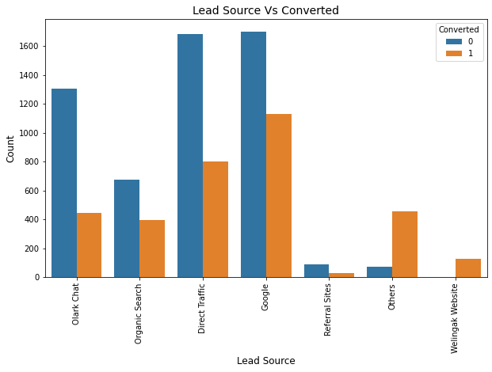
Data Analysis
Major conversion in the lead source is from 'Google', 'Direct Traffic'.

Slide 9
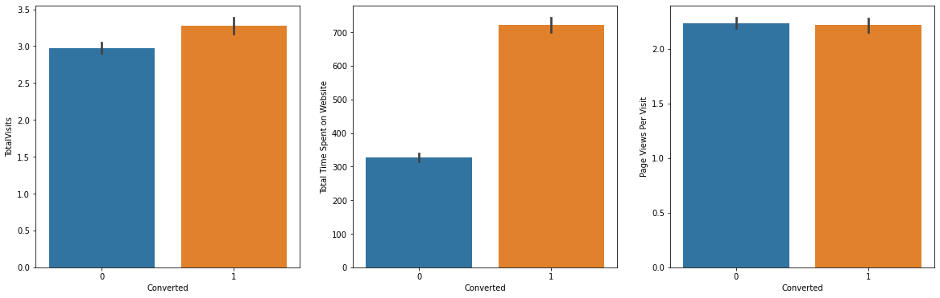
Data Analysis – Numeric Variables
We can observe that the Time spent on the website is good indicator for the conversion rate

Slide 10
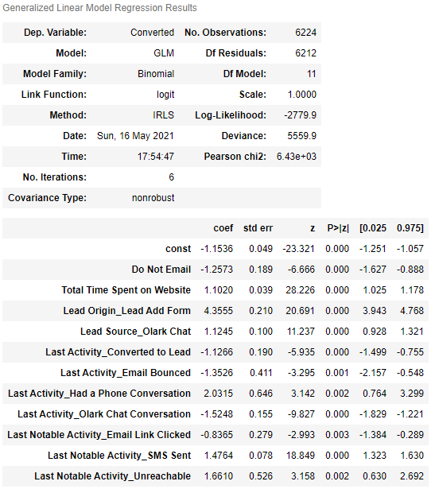
Model Selected
These are the top categorical/dummy variables in the model which should be focused the most on in order to increase the probability of lead conversion.
Lead Origin with Lead Add Form (coefficient – 4.356)
Last activity with Had a Phone Conversation (coefficient – 2.031)
Last Notable Activity with Unreachable (coefficient – 1.661)

Slide 11
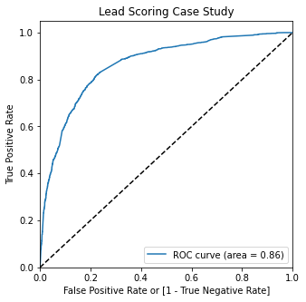
Model Evaluation - ROC Curve.
Area under ROC curve is 0.86 which is a good indicator for the model

Slide 12
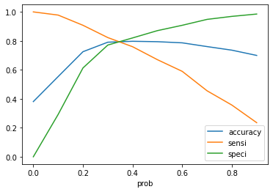
Model Evaluation Optimal Cut-off Point
From the curve above, 0.35 is the optimum point to take it as a cutoff probability.

Slide 13
Model Evaluation – Confusion Matrix of Train Data
Evaluation Metrics on Train Data
Accuracy – 79.24%
sensitivity – 79.58%
specificity – 79.02%
false positive rate – 20.97%
positive predictive value - 70%
Negative predictive value – 86.28%
Overall conversion rate predicted – 80%
3045
808
484
1887

Slide 14
Model Evaluation – Confusion Matrix of Test Data
Evaluation Metrics on Train Data
Accuracy – 80.13%
sensitivity – 80.81%
specificity – 79.72%
Precision – 70.69%
Recall – 80.81%
Overall conversion rate predicted – 81%
1325
337
193
813

Slide 15
Conclusion
While we have checked both Sensitivity-Specificity as well as Precision and Recall Metrics, we have considered the optimal cut off based on Sensitivity and Specificity for calculating the final prediction.
Accuracy, Sensitivity and Specificity values of test set are around 80%, 81% and 79.7% which are approximately closer to the respective values calculated using trained set.
Also the lead score calculated in the trained set of data shows the conversion rate on the final predicted model is 80%
Hence overall this model seems to be good.

Slide 16
THANK YOU

